Slide 1



DODGE IT!
Introdução à computação gráfica 24/25
Docente: Joaquim Madeira
Diogo Couto 104288

Slide 2
Index
Overall View
Models and Scene
Animations
Architecture
Future work
References

Slide 3
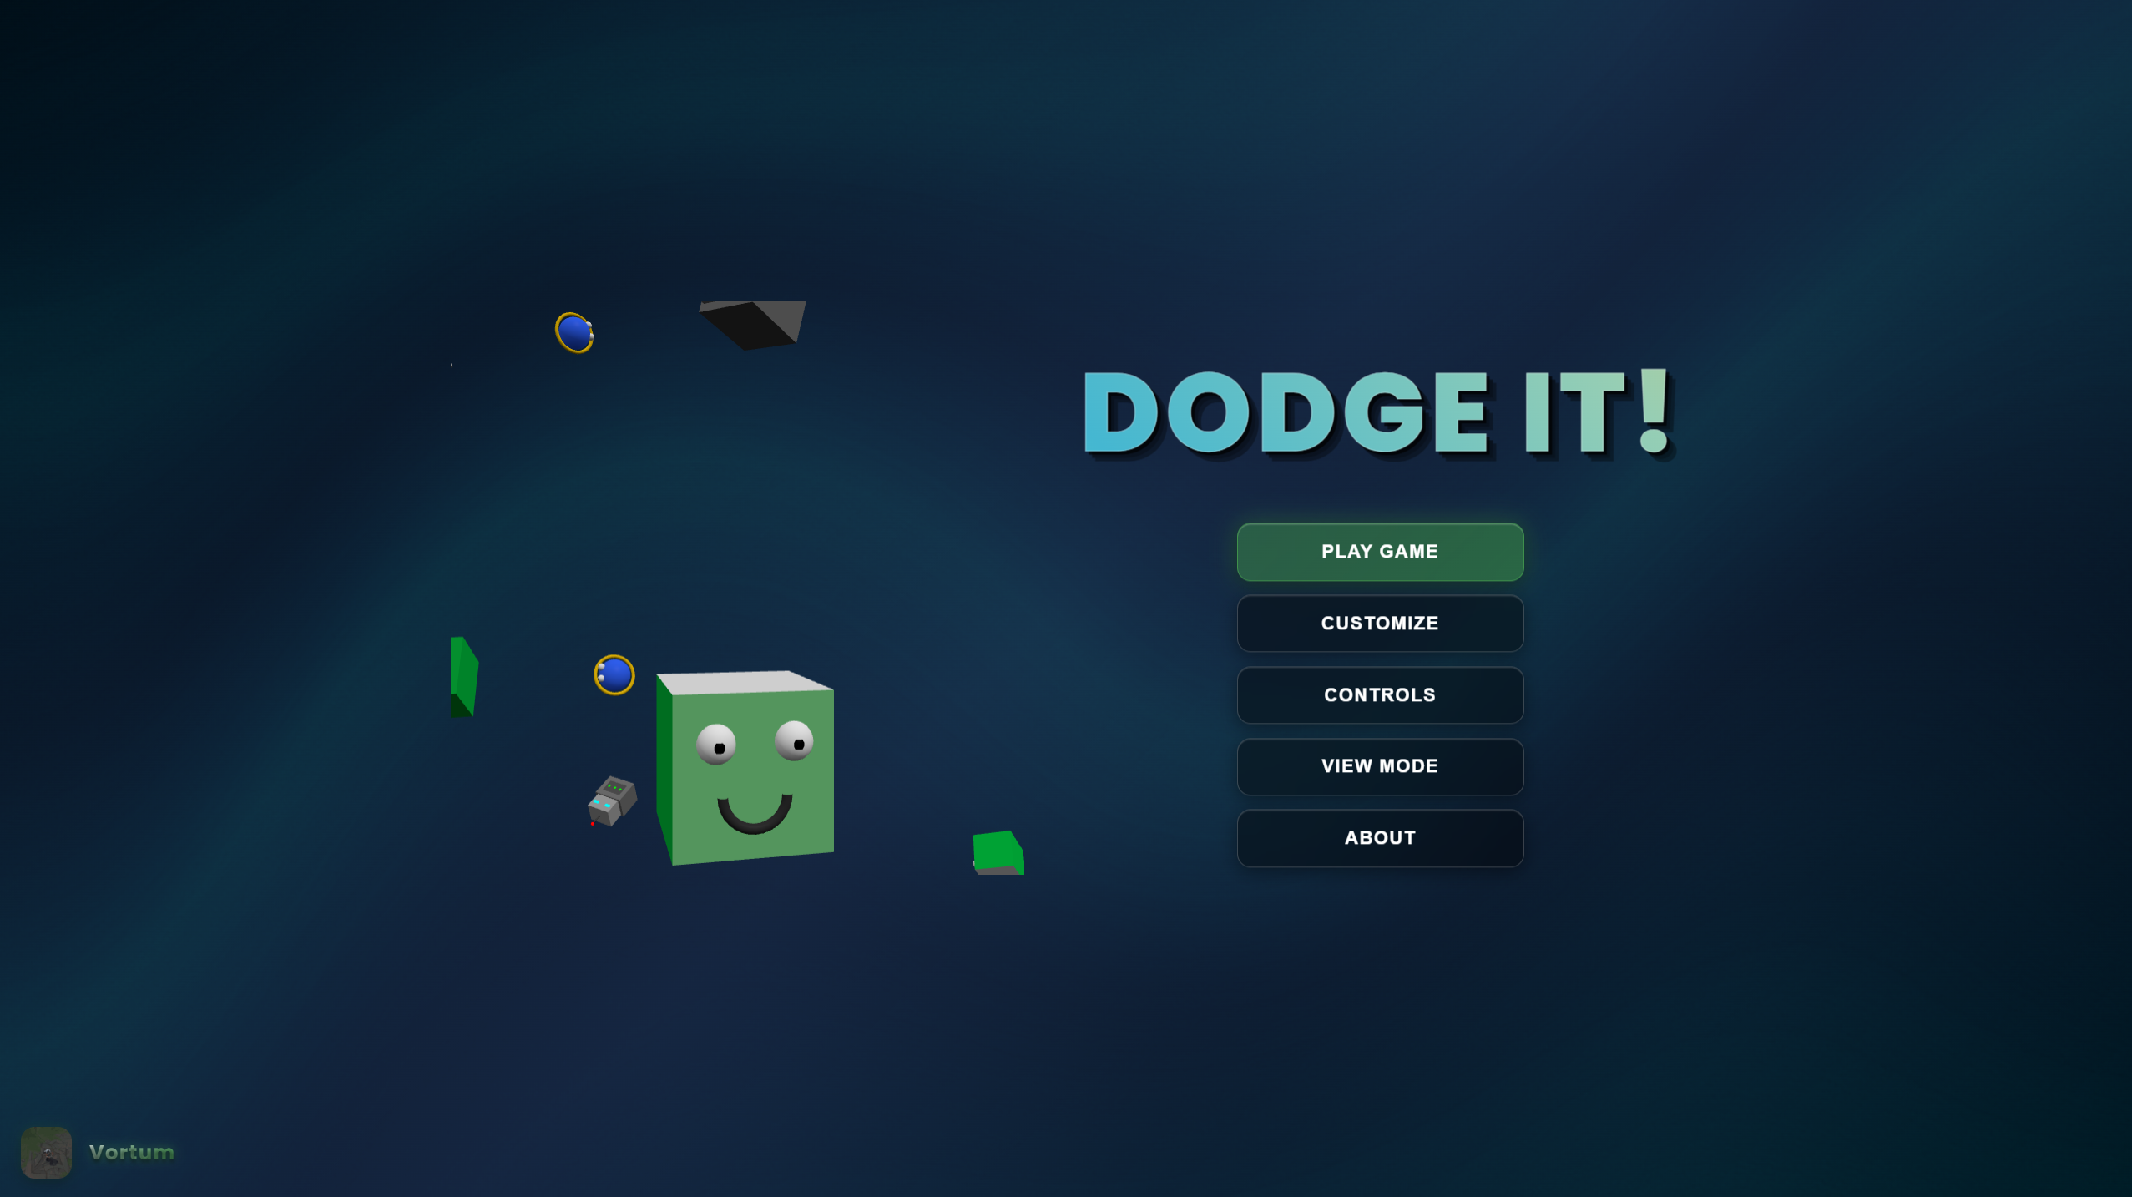
Overall View
Project core: 3D platformer – Jump between pillars, dodge balls, collect cupcakes, reach the end goal and navigate levels.

Slide 4
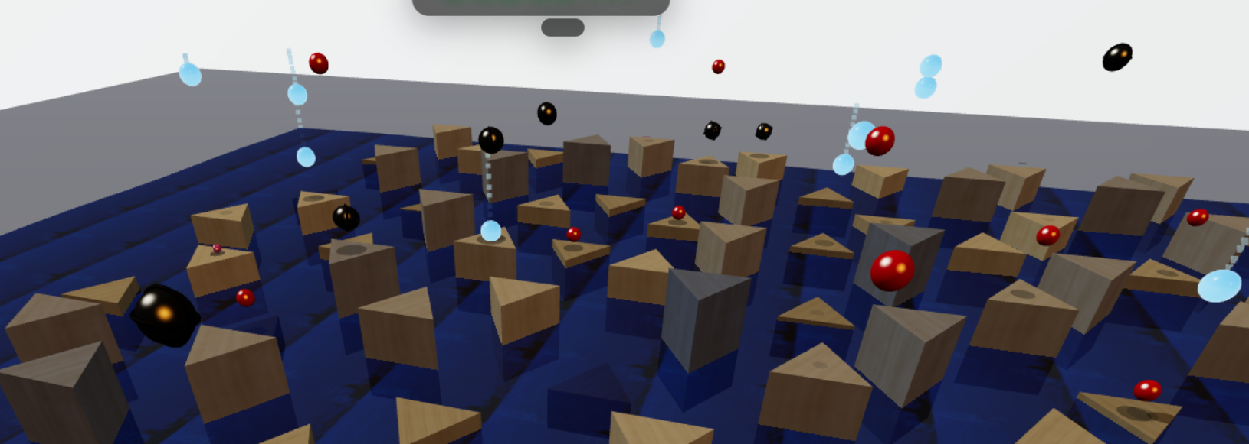
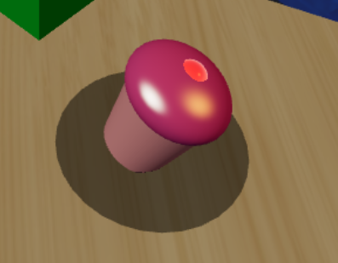
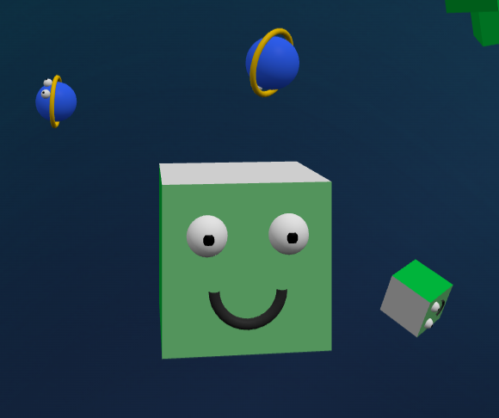

Models and Scene
Key Models:
Obstacles: 3 Ball types (Standard, Heavy, Light).
Collectibles: Cupcakes.
Player: Cube, Sphere, Robot.
Environment:
Goal: Glowing pillar with a tall, bright marker.
Terrain Pillars: Procedurally generated using Simplex Noise for natural height variation. Textured differently per level.

Slide 5
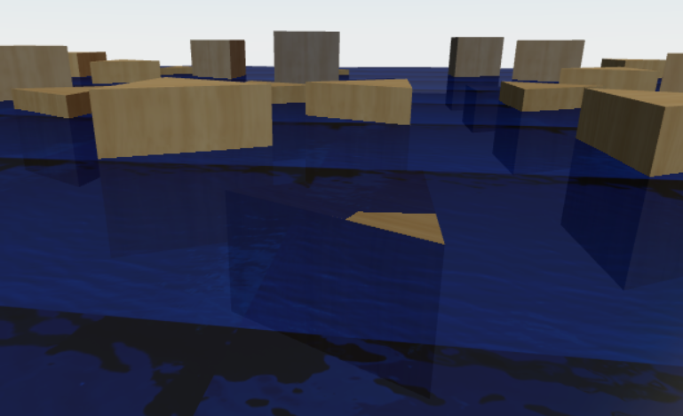
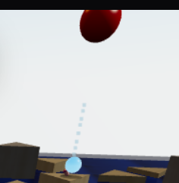

Animations
Programmatic: Cupcake floating/rotation, Cloud drift, Water waves (L1).
Core Animations:
Physics-Driven: Player & Ball movement (falling, rolling, jumping).
Visual Effects:
Particle effects (ball hit/bounce/trail, cupcake collection).
Dynamic shadows (scaling/fading).
How: Cannon-es for physics; Three.js/JS for programmatic & particle effects; CSS for UI.

Slide 6
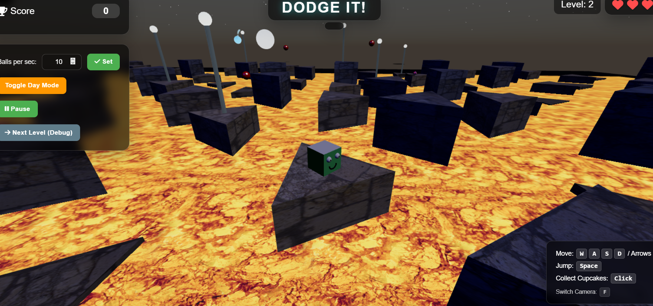
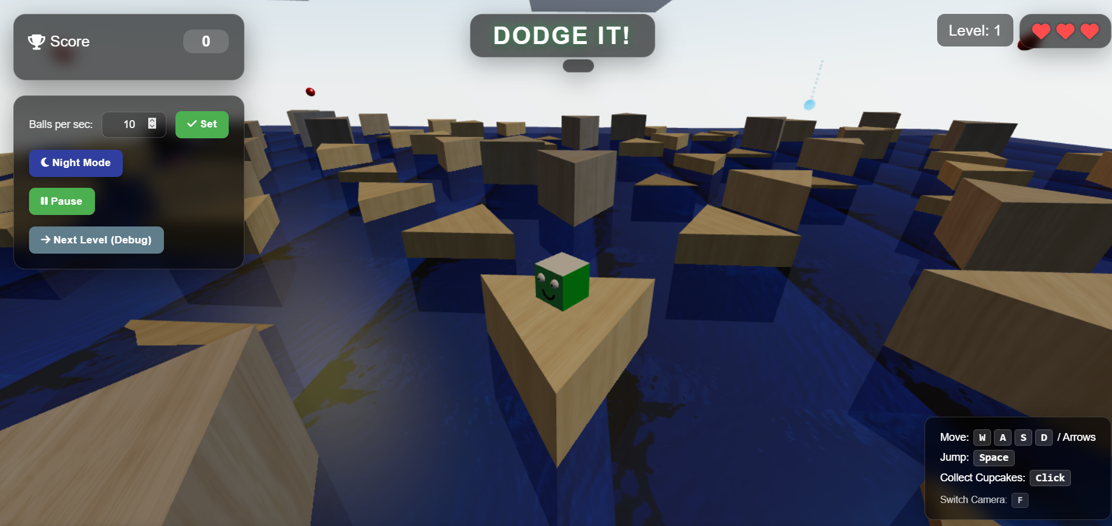
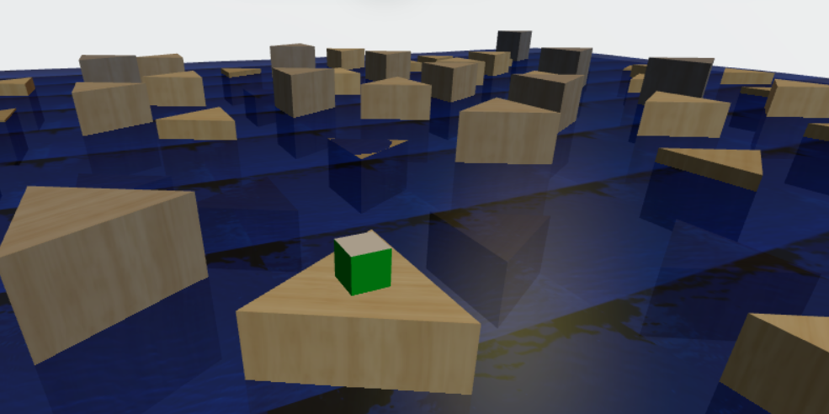
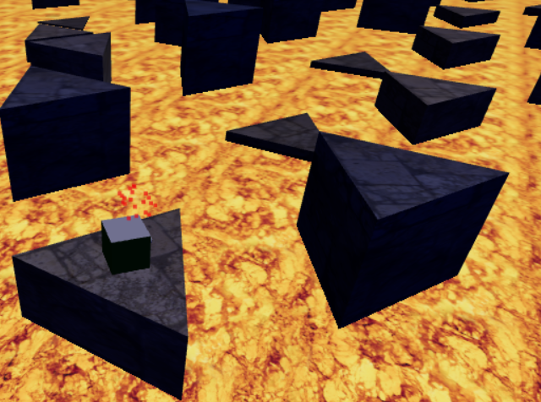
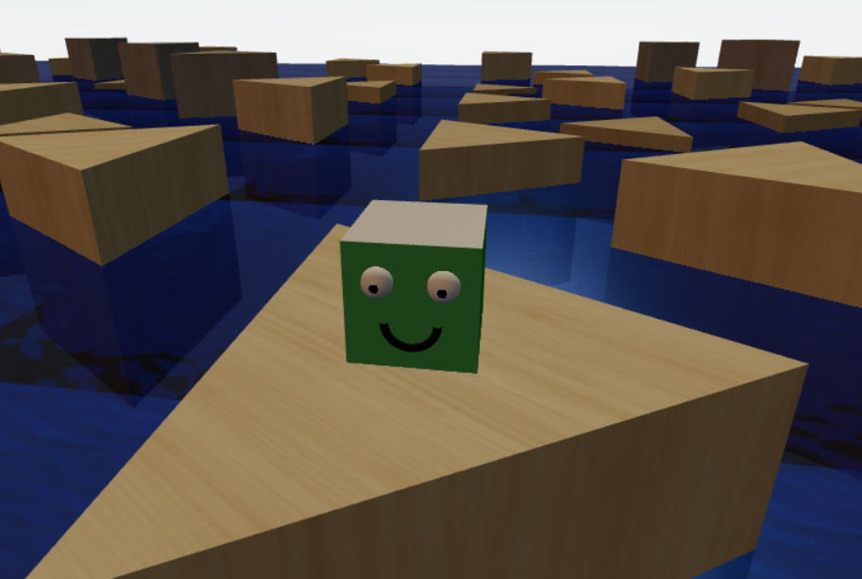
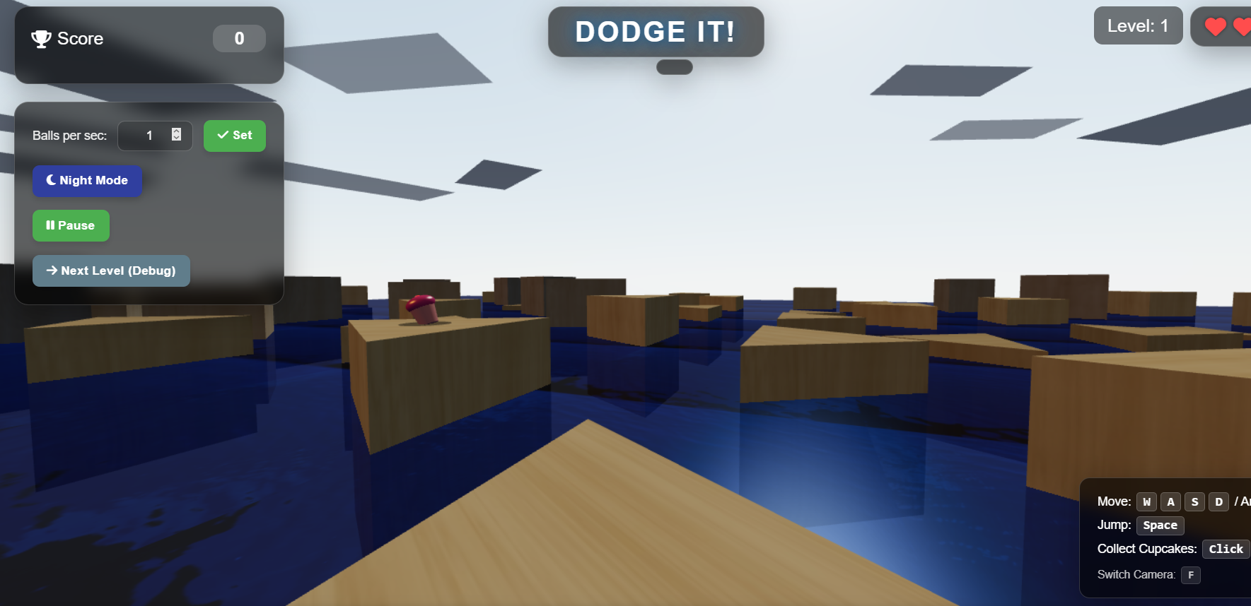
Multiple levels (day/night themes).
Procedural terrain (simplex noise)
Switch camera (F key - 1st/3rd person).

Slide 7
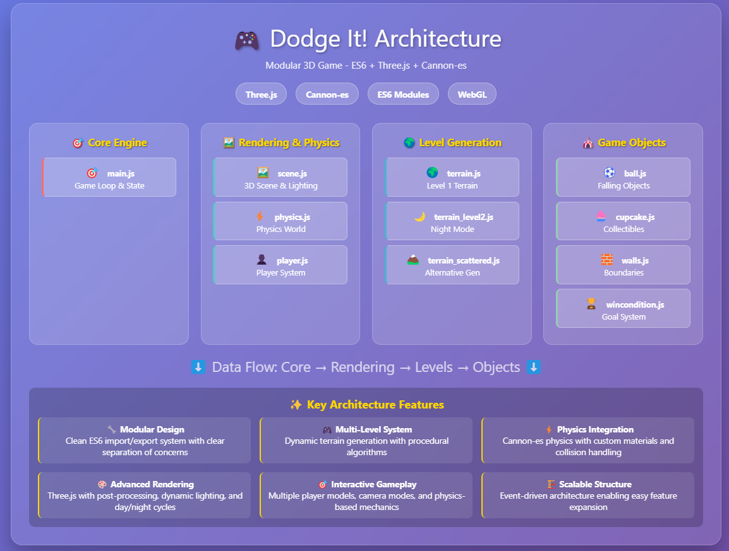
Project Architecture

Slide 8
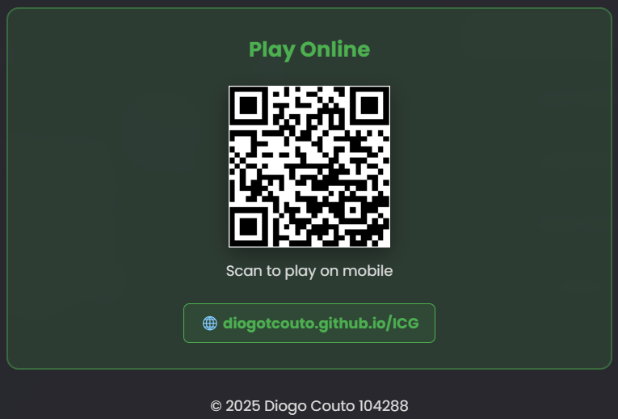
Future Work
Add more player models
Add more levels and increase level complexity
Add diverse terrain generation
Add more models and falling objects

Slide 9
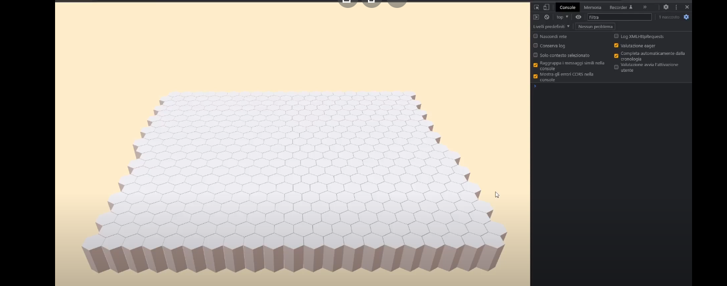
References:
https://www.youtube.com/watch?v=5iUVtIZoD0Y Guide used about using simplex noise for terrain generation

